Slide 1

E R Diagram

Slide 2
E R Diagram
Any object, for example, entities, attributes of an entity, relationship sets, and attributes of relationship sets, can be represented with the help of an ER diagram.

Slide 3
E R Diagram
Entity:
Entities are represented by means of rectangles. Rectangles are named with the entity set they represent.

Slide 4
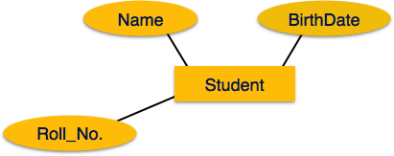
E R Diagram
Attributes:
Attributes are the properties of entities. Attributes are represented by means of ellipses. Every ellipse represents one attribute and is directly connected to its entity (rectangle).

Slide 5
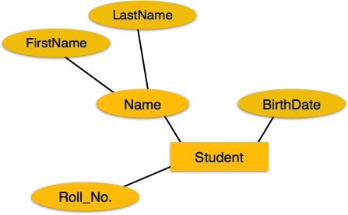
E R Diagram
Attributes:
If the attributes are composite, they are
further divided in a tree like structure.
Every node is then connected to its
attribute. That is, composite attributes
are represented by ellipses that are connected with an ellipse.

Slide 6
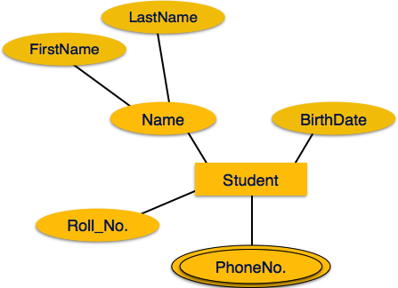
E R Diagram
Attributes:
Multivalued attributes are depicted
by double ellipse.

Slide 7
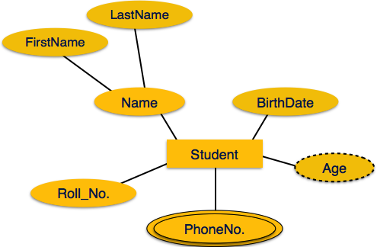
E R Diagram
Attributes:
Derived attributes are depicted by dashed ellipse.

Slide 8
E R Diagram
Relationship:
Relationships are represented by diamond-shaped box. Name of the relationship is written inside the diamond-box. All the entities (rectangles) participating in a relationship, are connected to it by a line.

Slide 9
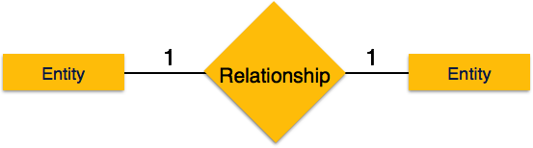
E R Diagram
Relationship(One-to-One):
When only one instance of an entity is associated with the relationship, it is marked as '1:1'. The following image reflects that only one instance of each entity should be associated with the relationship. It depicts one-to-one relationship.

Slide 10
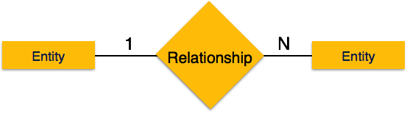
E R Diagram
Relationship(One-to-Many):
When more than one instance of an entity is associated with a relationship, it is marked as '1:N'. The following image reflects that only one instance of entity on the left and more than one instance of an entity on the right can be associated with the relationship. It depicts one-to-many relationship.

Slide 11
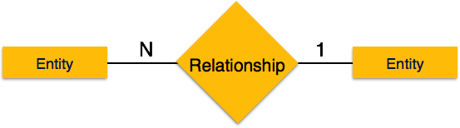
E R Diagram
Relationship(Many-to-One):
When more than one instance of entity is associated with the relationship, it is marked as 'N:1'. The following image reflects that more than one instance of an entity on the left and only one instance of an entity on the right can be associated with the relationship. It depicts many-to-one relationship.

Slide 12

E R Diagram
Relationship(Many-to-Many):
The following image reflects that more than one instance of an entity on the left and more than one instance of an entity on the right can be associated with the relationship. It depicts many-to-many relationship.

Slide 13
PName
Pat-id
Hosp-id
HName
HAddress
Example: E R Diagram
PDiagnosis
Hcity
PAddress
N
Admitted
1
Patient
Hospital
1
N
1
has
has
check
1
N
N
Medical_Record
Doctor
Doc-id
Record-id
Problem
Dname
Date_of_examination
Salary
Qualification

Slide 14
E R Diagram
Converting the E-R Diagram into Tables:
Hospital
Hosp-id | Primary Key
HCity
HAddress
HName
Pat-id | Foreign key references to Pat-id of Patient table
Doc-id | Foreign key references to Doc-id of Doctor table

Slide 15
E R Diagram
Converting the E-R Diagram into Tables:
Patient
Pat-id | Primary Key
PName
PAddress
PDiagnosis
Record-id | Foreign key references to Record-id of Medical_Record table
Hosp-id | Foreign key references to Hosp-id of Hospital table
Doc-id | Foreign key references to Hosp-id of Doctor table

Slide 16
E R Diagram
Converting the E-R Diagram into Tables:
Medical_Record
Record-id | Primary Key
Problem
Date_of_examination
Pat-id | Foreign key references to Pat-id of Patient table

Slide 17
E R Diagram
Converting the E-R Diagram into Tables:
Doctor
Doc-id | Primary Key
DName
Qualification
Salary
Hosp-id | Foreign key references to Hosp-id of Hospital table
Pat-id | Foreign key references to Hosp-id of Patient table

Slide 18
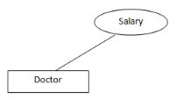
E R Diagram
Mapping of Attributes:
Simple Attributes:
Simple Attributes which can not be divided into subparts.
Example: Salary of Doctor

Slide 19
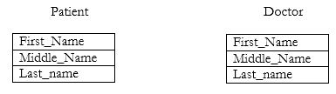
E R Diagram
Mapping of Attributes:
Composite Attributes:
Composite Attributes which can be divided into subparts.
Example: Patient Name, Doctor Name

Slide 20
E R Diagram
Mapping of Relationships:
Foreign Key approach:
Hospital_Patient
Pat-id | Hospital table makes foreign key references to Pat-id of Patient table
Hosp-id | Patient table makes foreign key references to Hosp-id of Hospital table

Slide 21
E R Diagram
Mapping of Relationships:
Foreign Key approach:
Hospital_Doctor
Hosp-id | Doctor table makes foreign key references to Hosp-id of Hospital table
Doc-id | Hospital table makes foreign key references to Doc-id of Doctor table

Slide 22
E R Diagram
Mapping of Relationships:
Foreign Key approach:
Patient_MedicalRecord
Pat-id | Medical Record table makes foreign key references to Pat-id of Patient table
Record-id | Patient table makes foreign key references to Record-id of Medical Record table

Slide 23
E R Diagram
Mapping of Relationships:
Foreign Key approach:
Patient_Doctor
Pat-id | Doctor table makes foreign key references to Pat-id of Patient table
Doc-id | Patient table makes foreign key references to Doc-id of Doctor table

Slide 24
E R Diagram
Identifying the relationships:
a. Hospital has a set of patients.
Therefore the relations is 1……..N.
b. Hospital has a set of doctors.
Therefore the relations is 1……..N.

Slide 25
E R Diagram
Identifying the relationships:
c. Since a doctor is associated with many patients.
Therefore the relations is 1……..N.
d. Each patient has record of various test and examination conducted.
Therefore the relations is 1……..N.

Slide 26
Thank You

